Slide 1
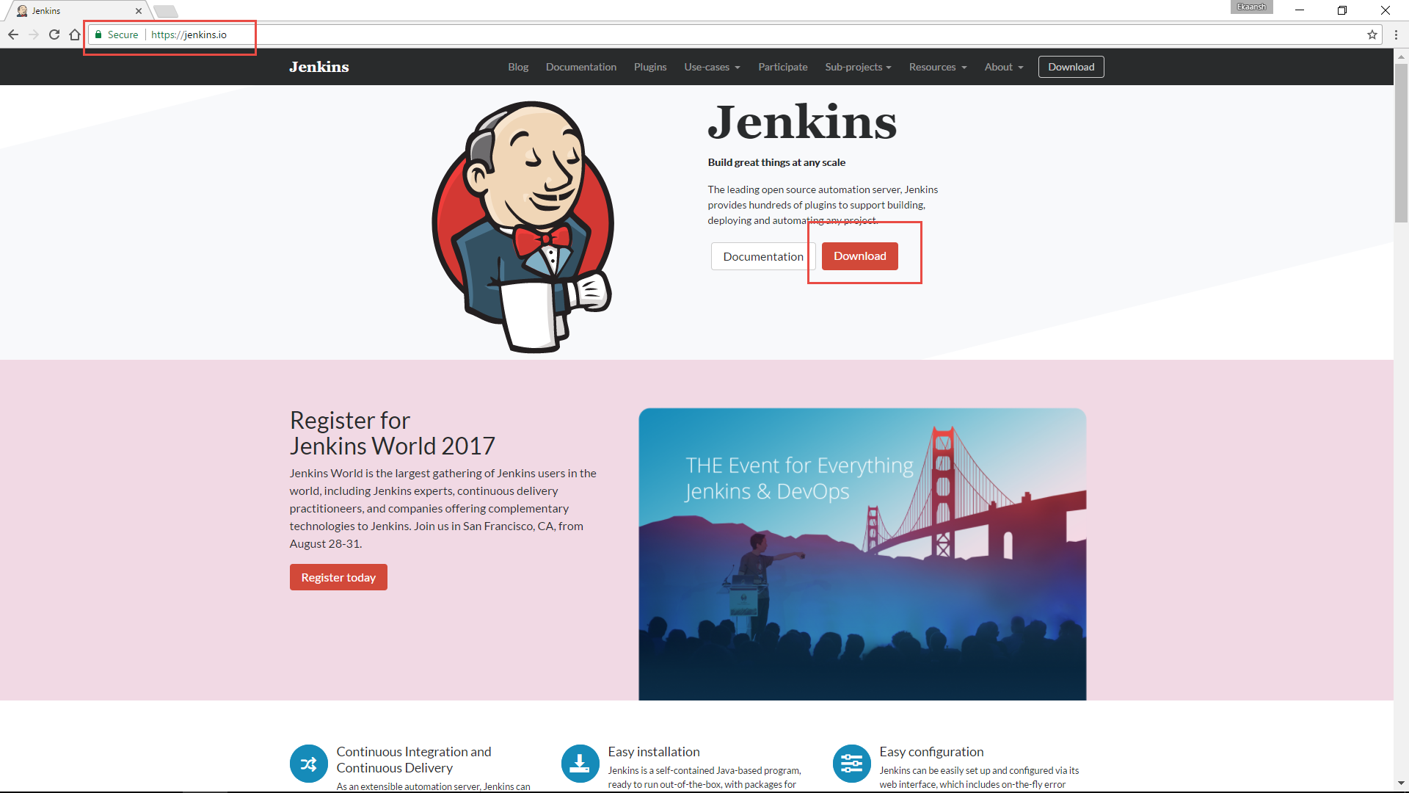
Navigate to Jenkins.io

Slide 2
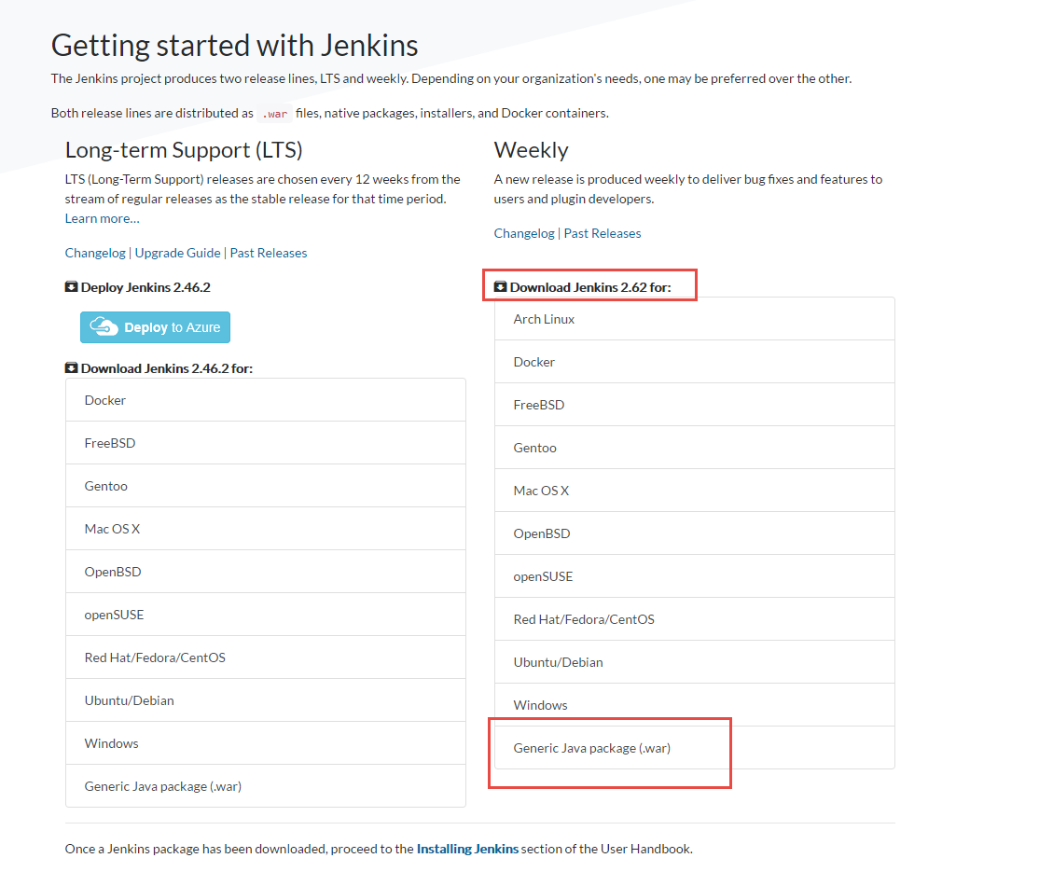
Download .WAR file

Slide 3
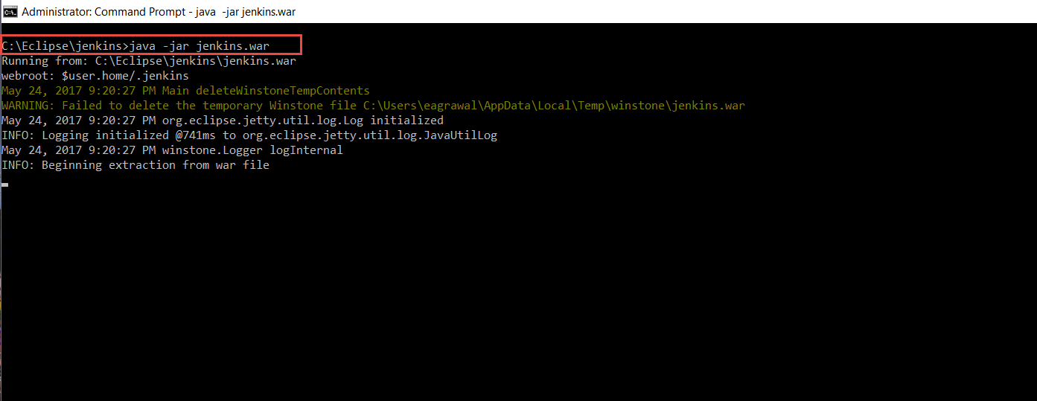
Open Command Prompt and follow the commands.
<Jenkins.war path> java -Dhudson.model.DirectoryBrowserSupport.CSP="sandbox allow-scripts; default-src 'self'; script-src * 'unsafe-eval'; img-src *; style-src * 'unsafe-inline'; font-src *" -jar jenkins.war --httpPort=8085

Slide 4
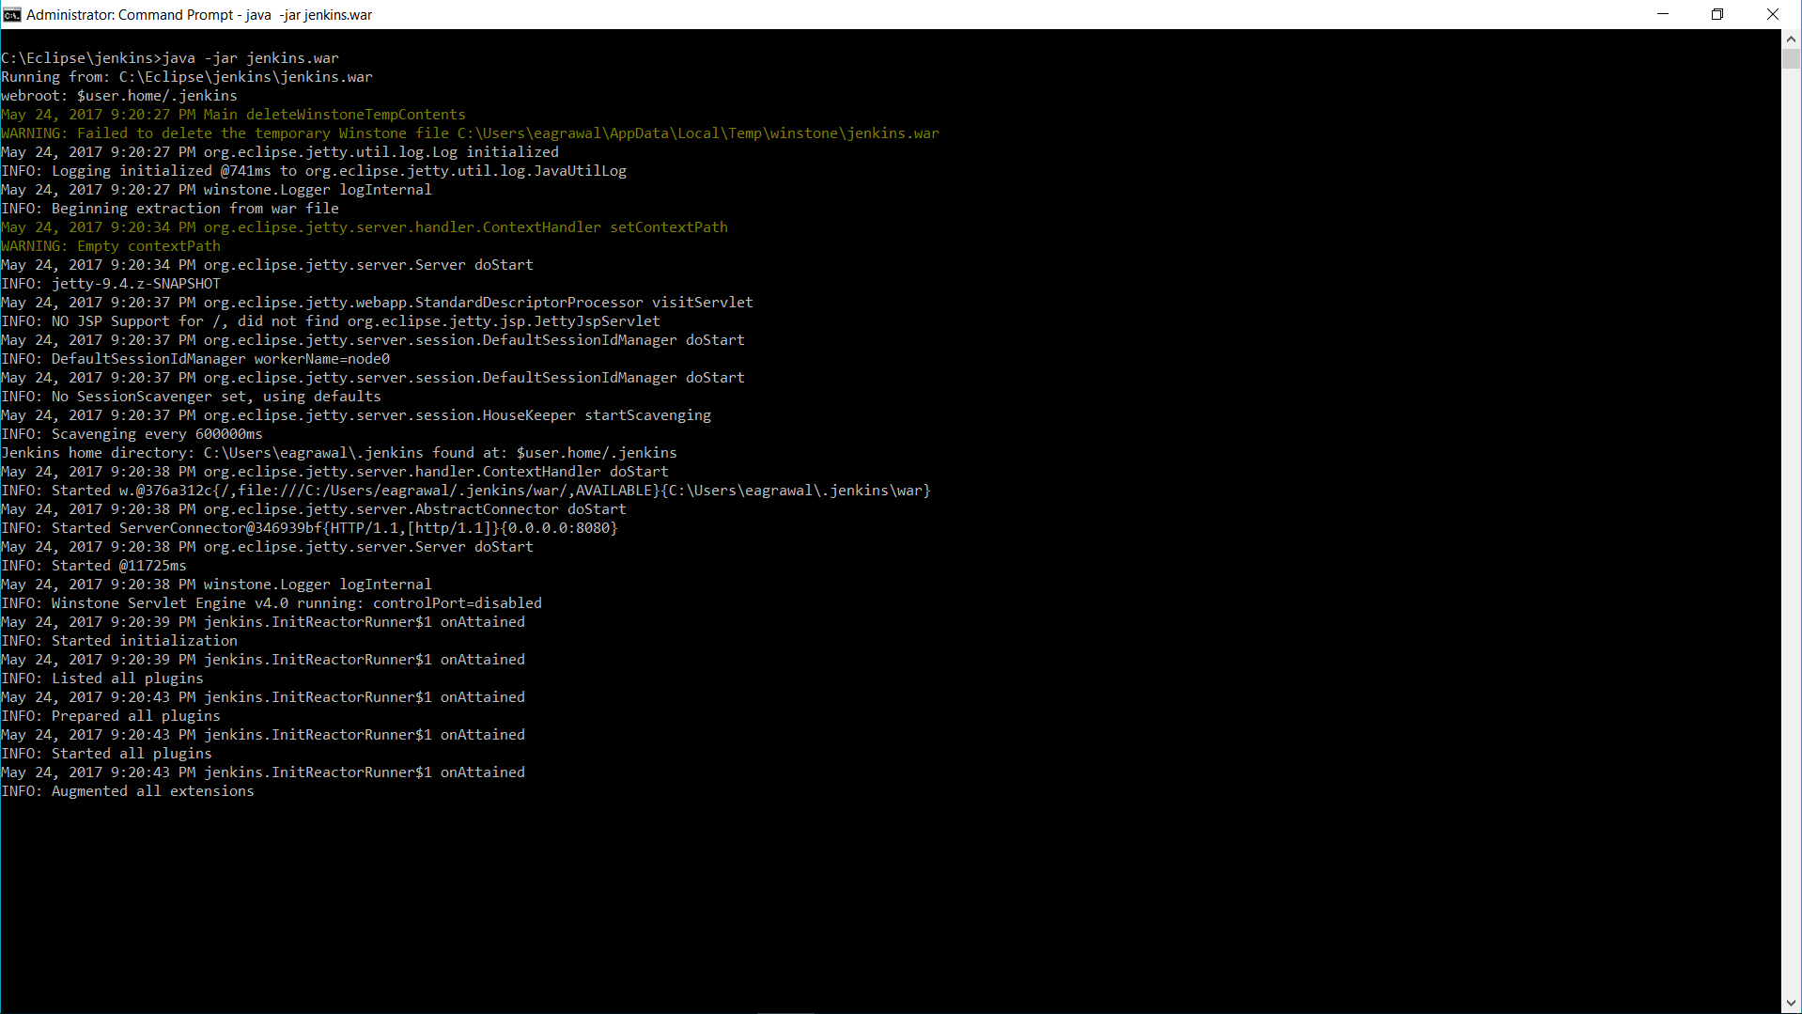
Wait for it to process

Slide 5
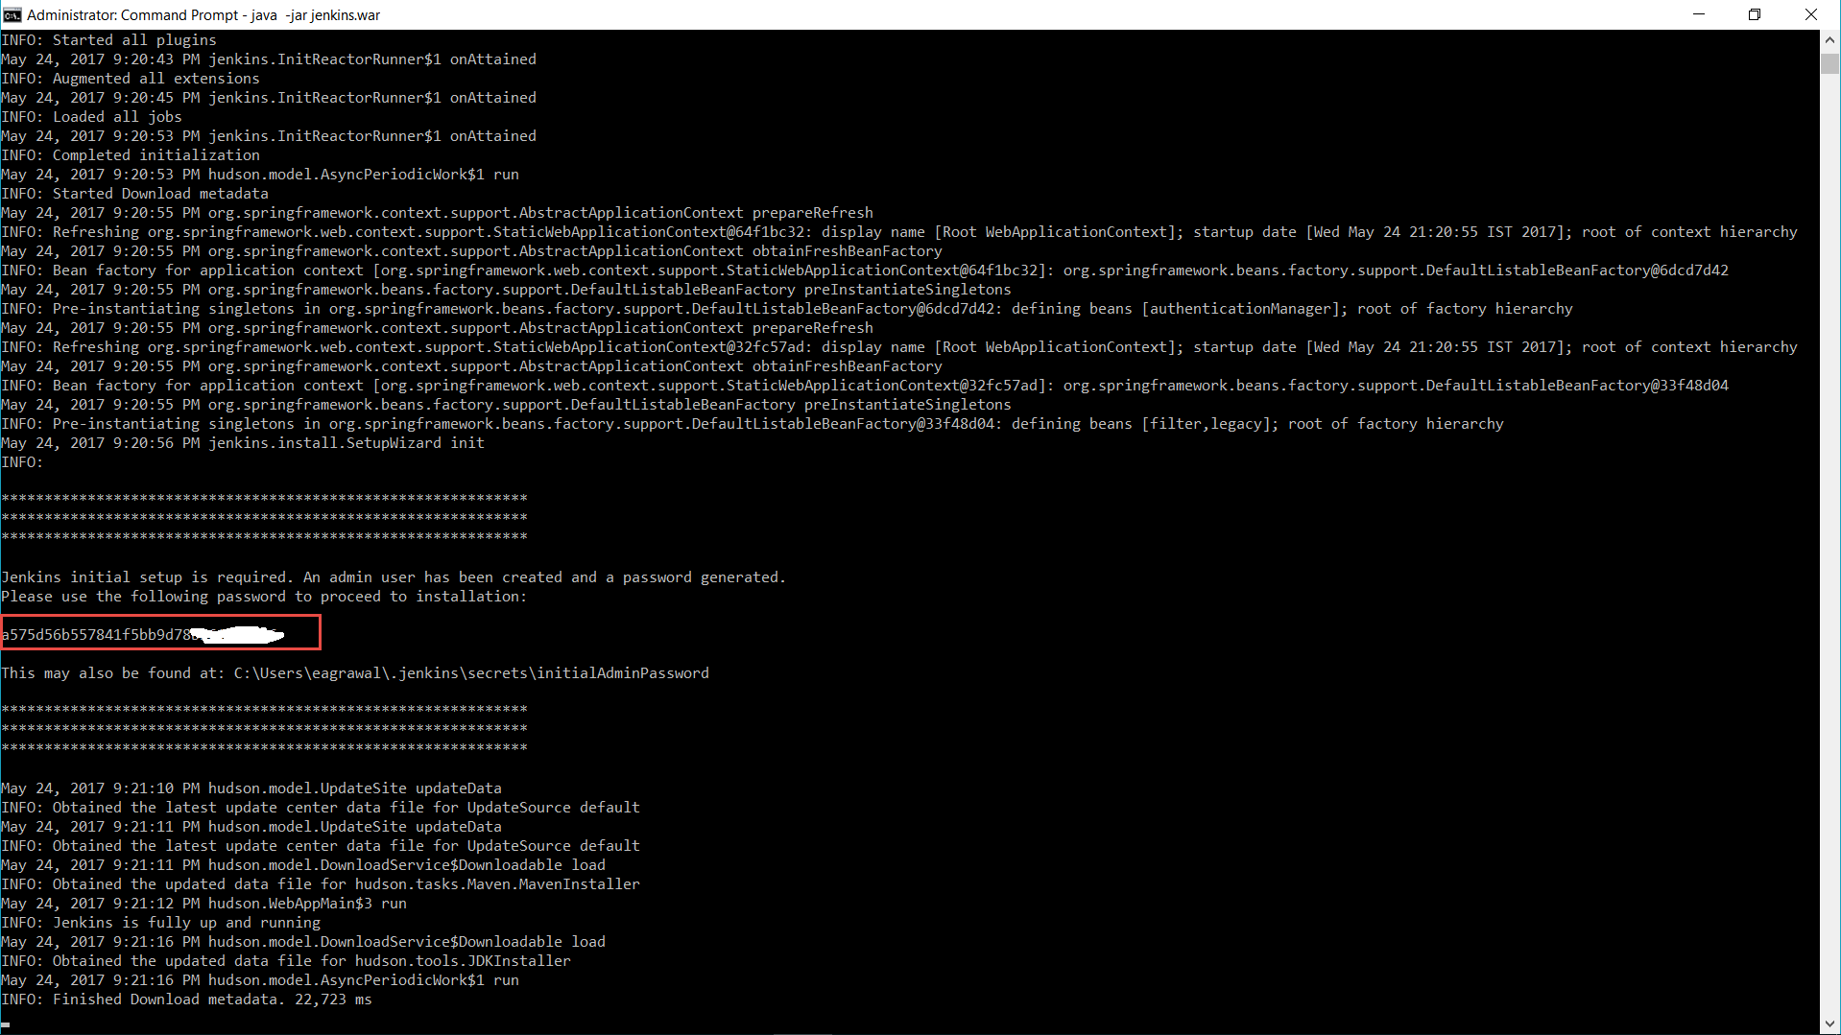
Copy the password generated for the admin console, do not close the cmd prompt.

Slide 6
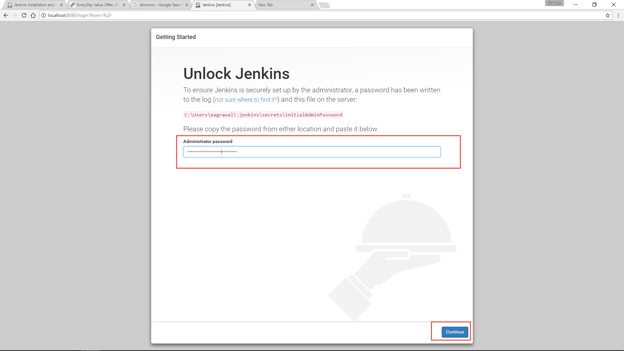
Open Browser and navigate to localhost:8085/ and provide with the password from previous step.

Slide 7
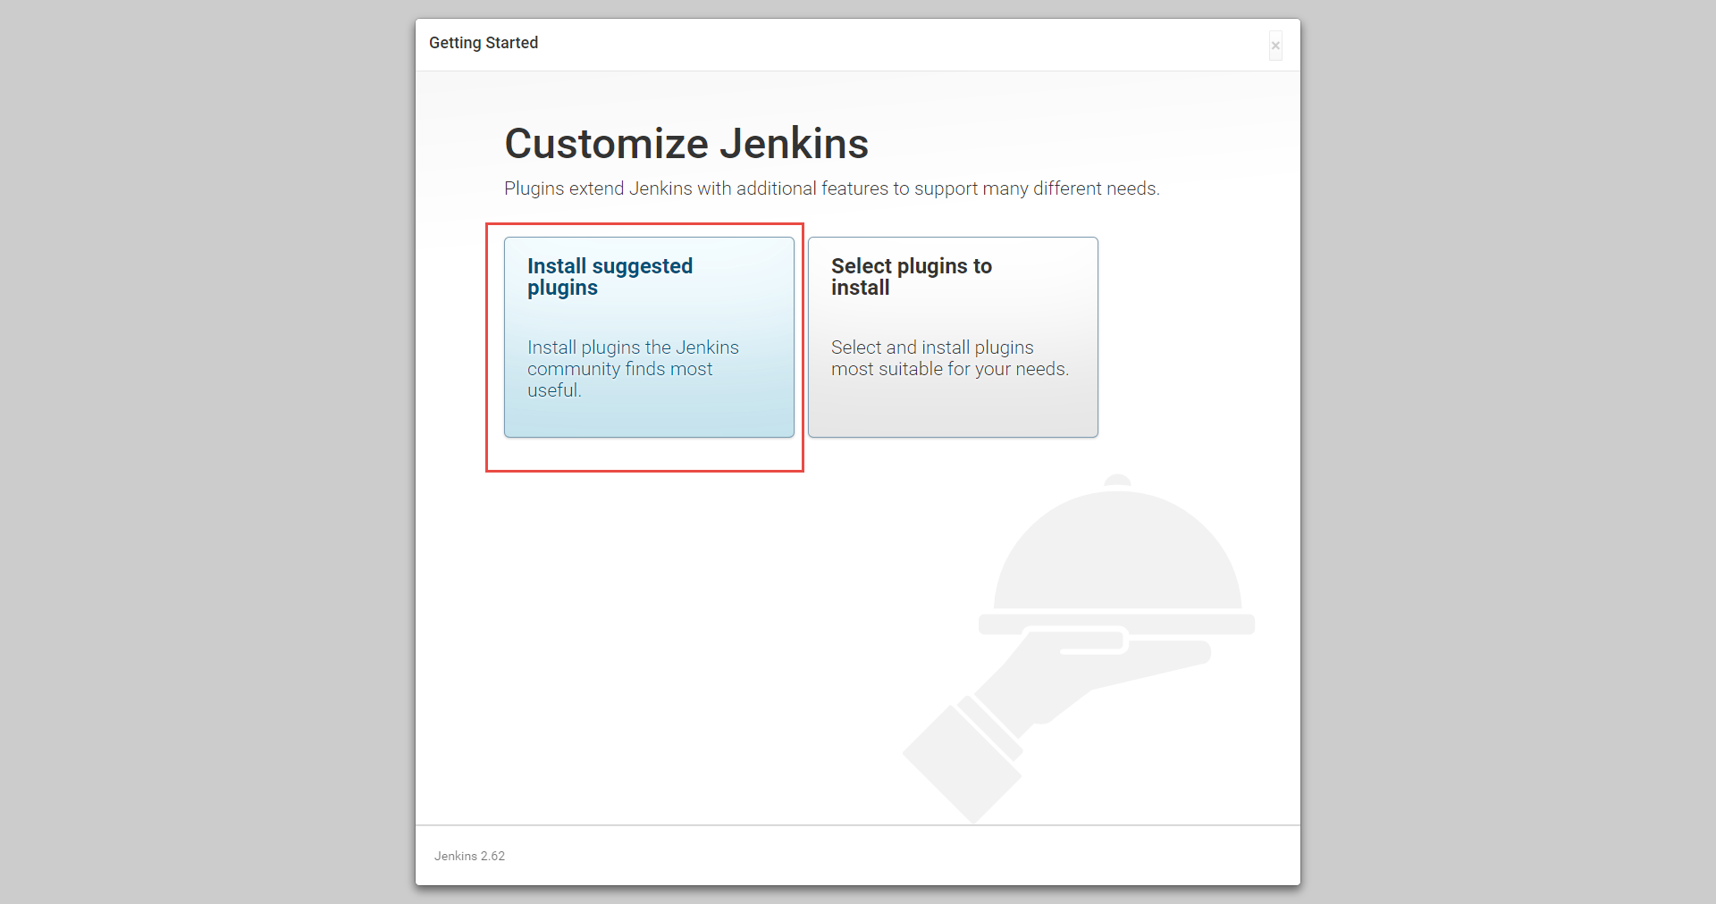
Install suggested plugins

Slide 8
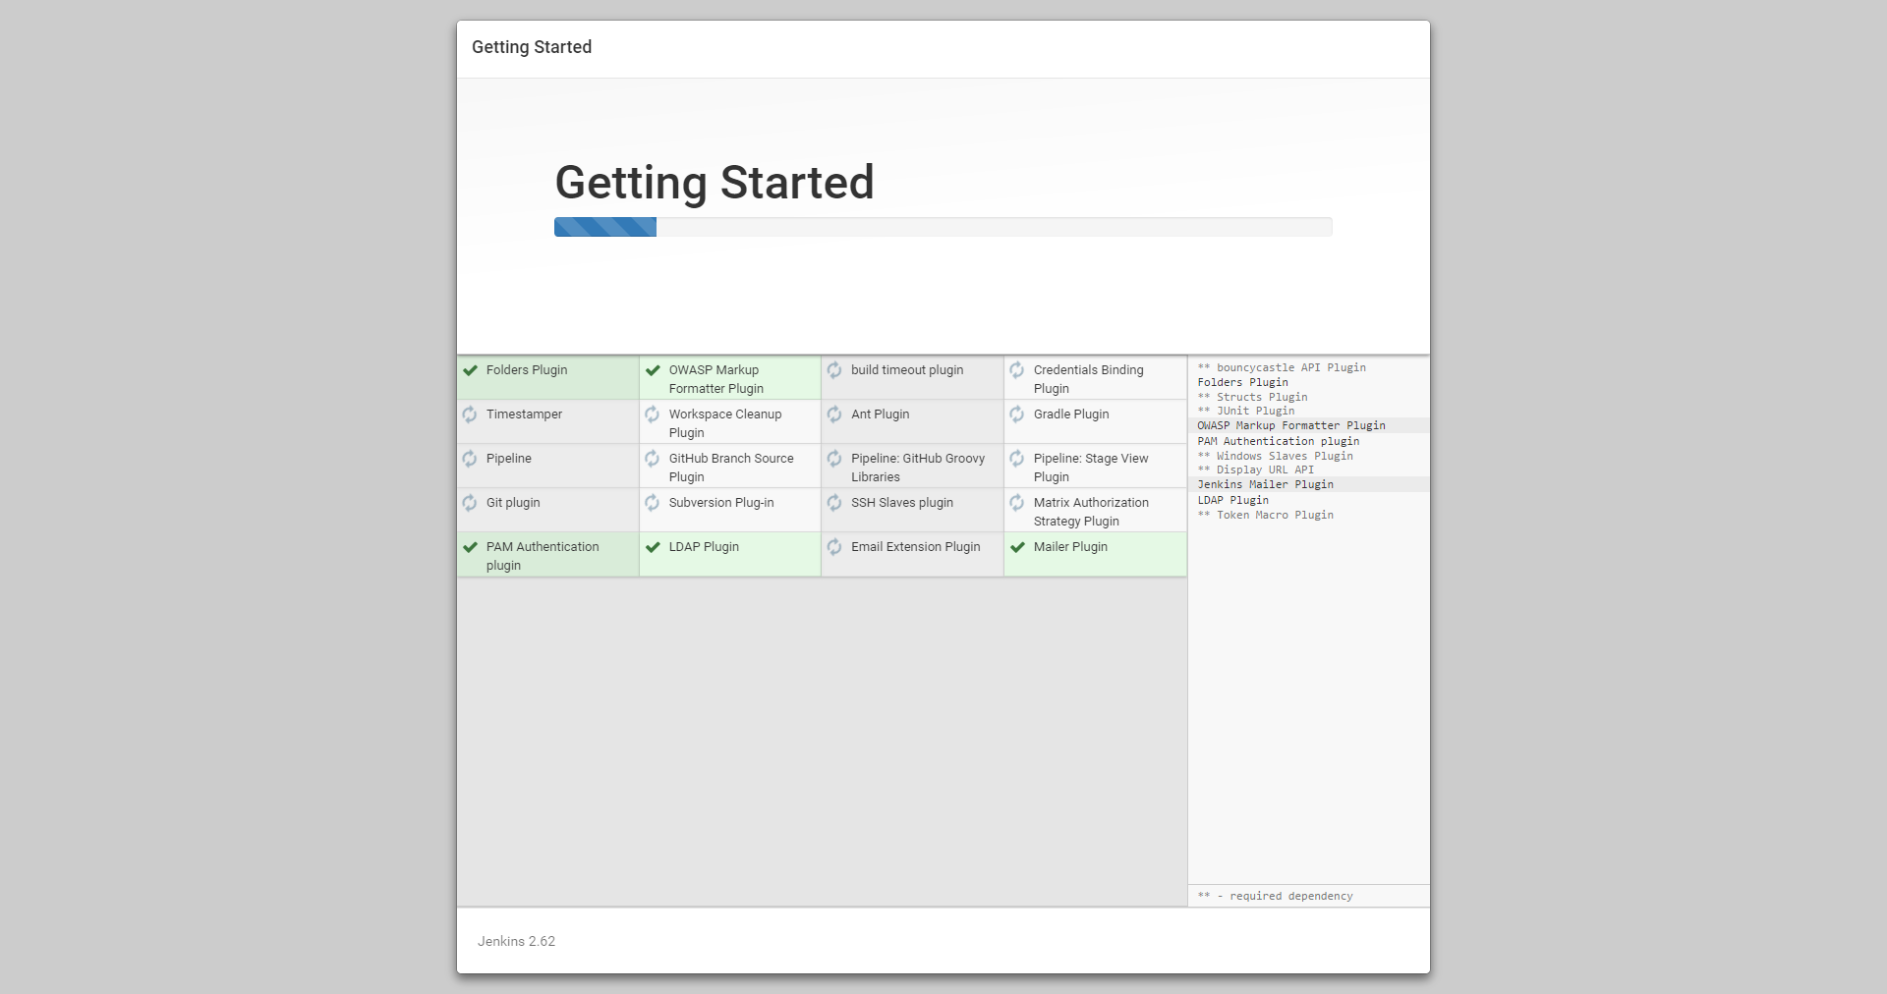
Wait for plugins to get installed

Slide 9
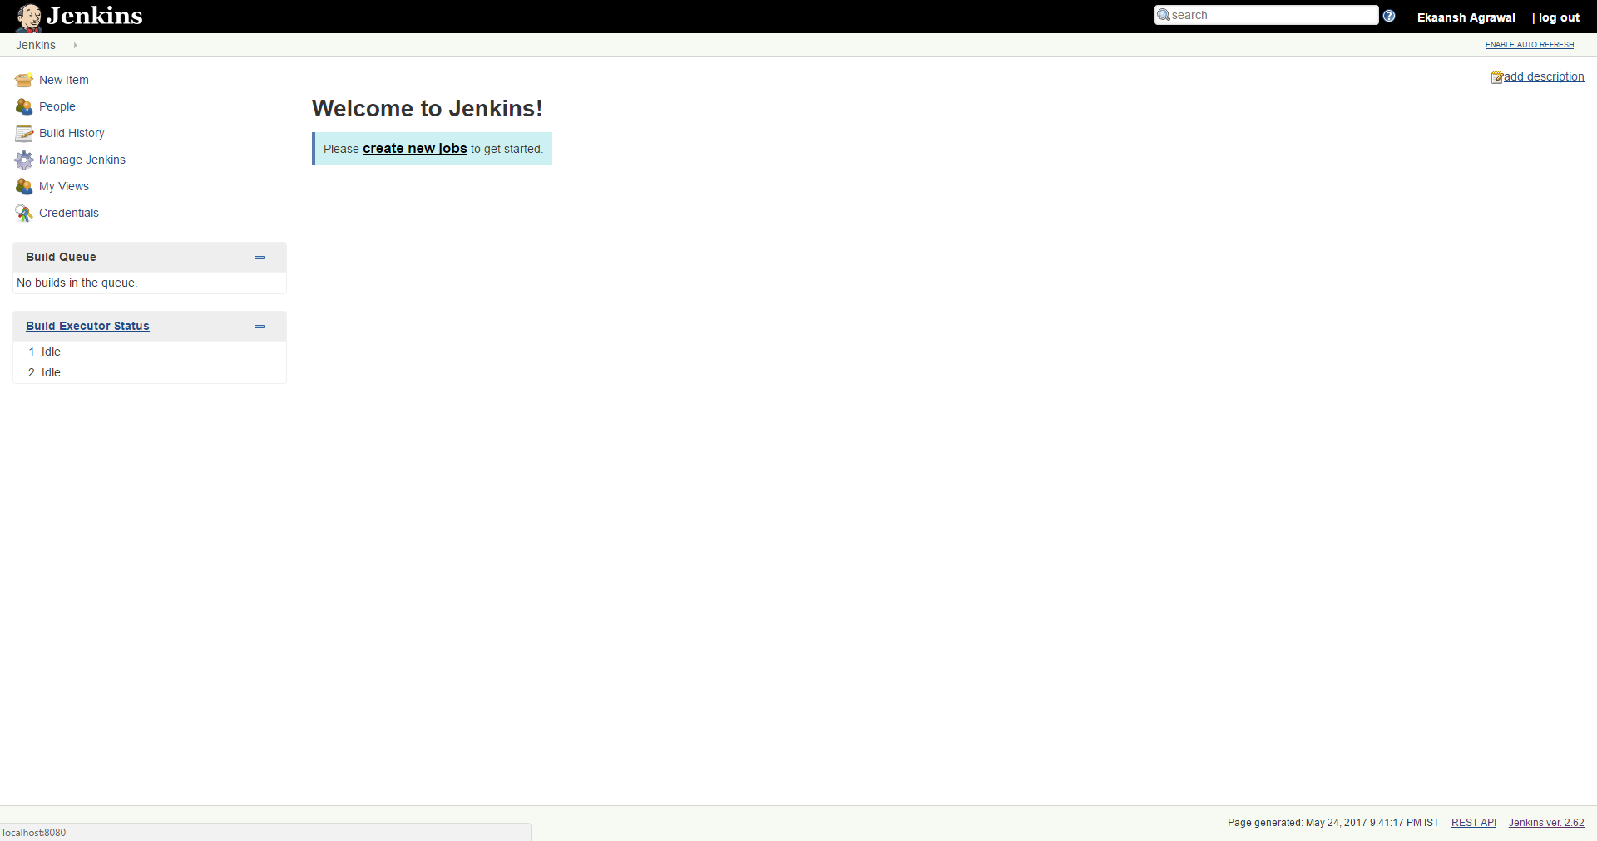
You are Ready to go

Slide 10
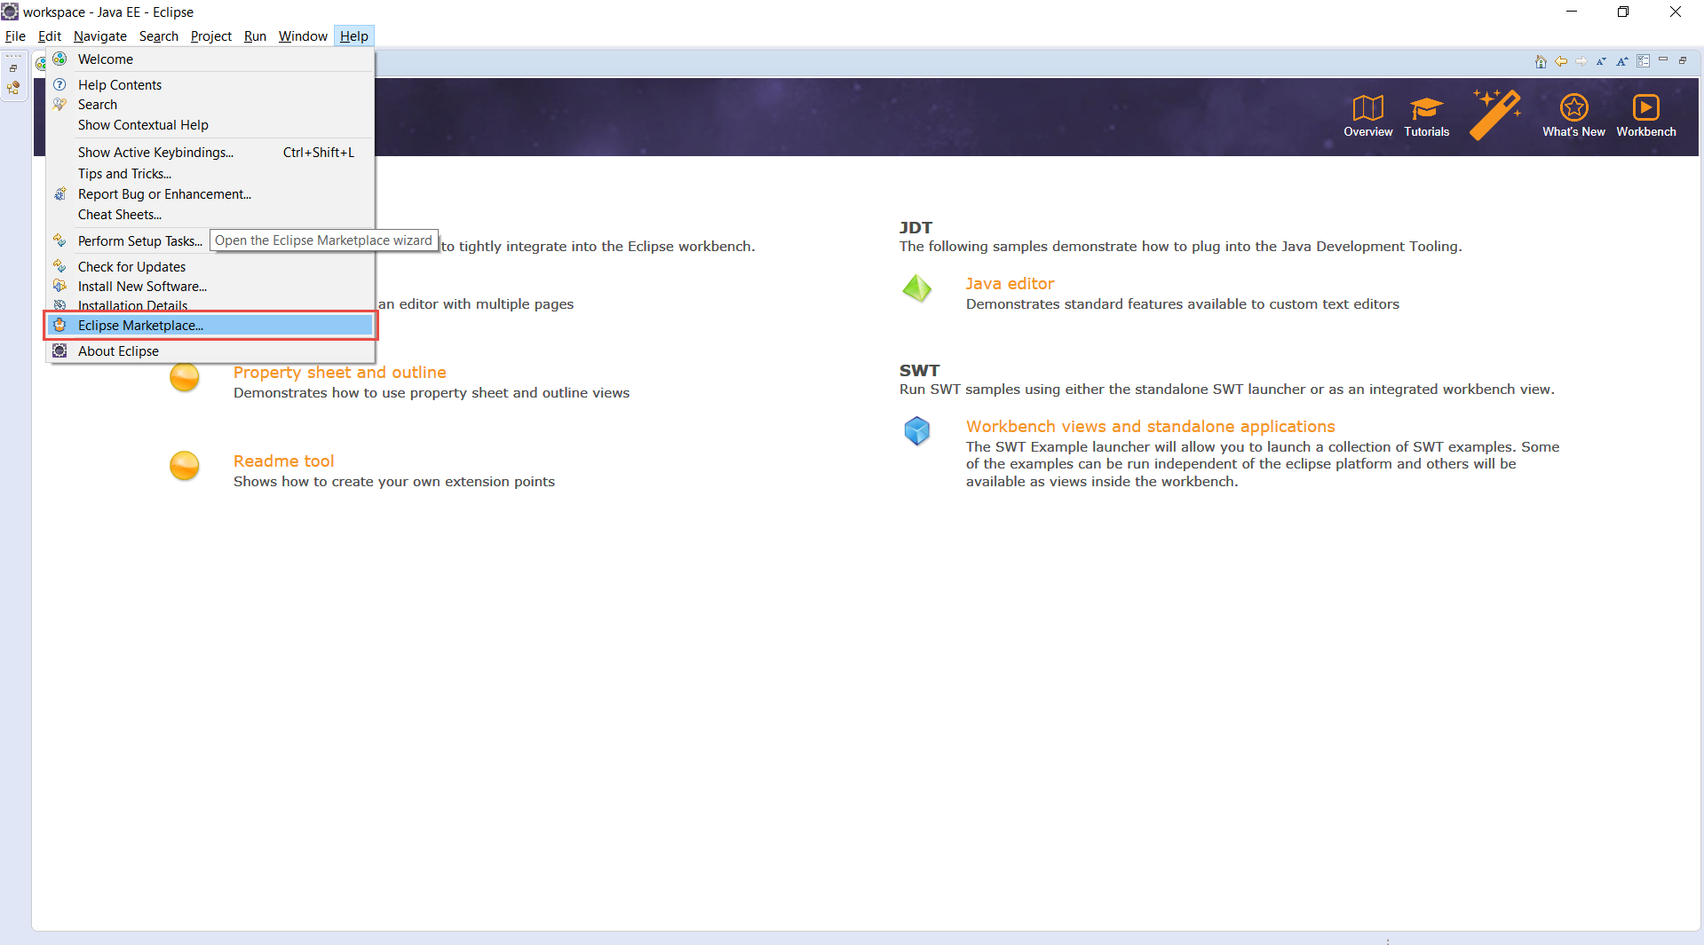
Download Eclipse Photon from given URL : Download
Open Eclipse and navigate to eclipse marketplace

Slide 11
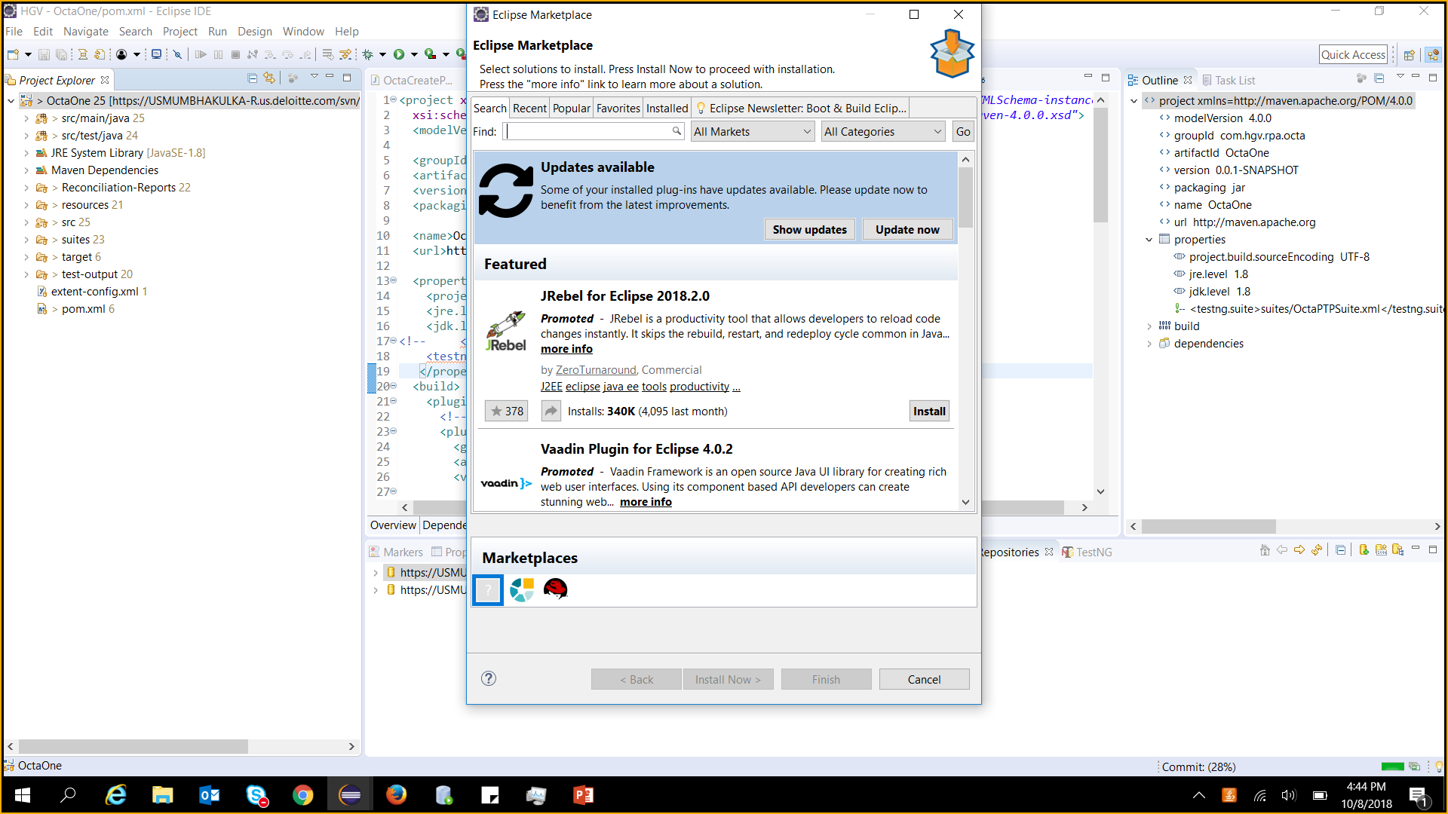
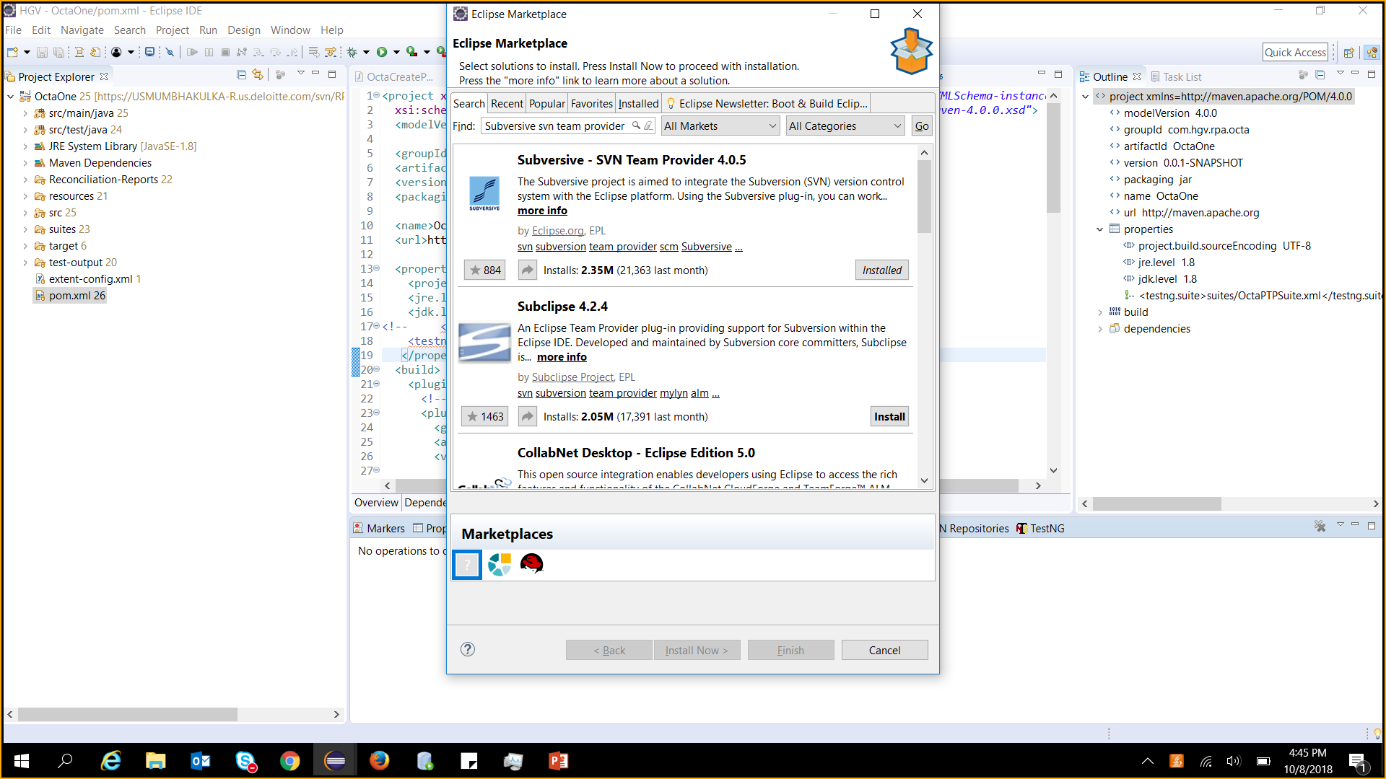
Follow the navigation → Type- Subversive svn team provider → click on Install

Slide 12
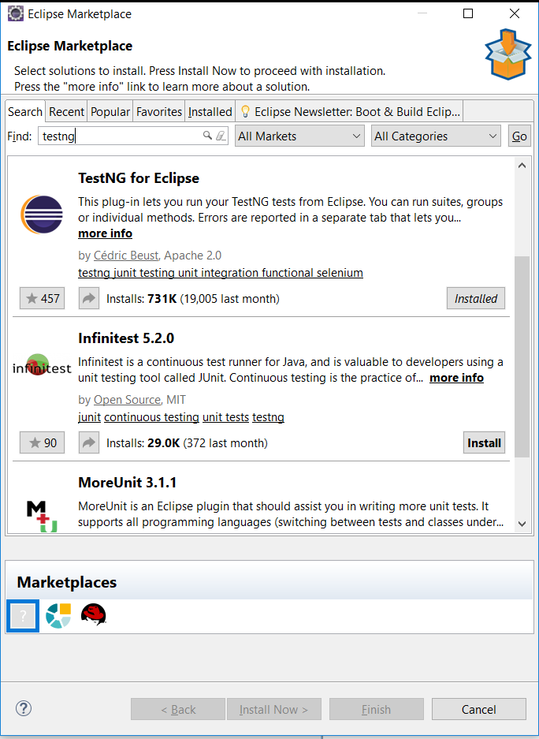
Follow the navigation → Type- Testng → click on install

Slide 13
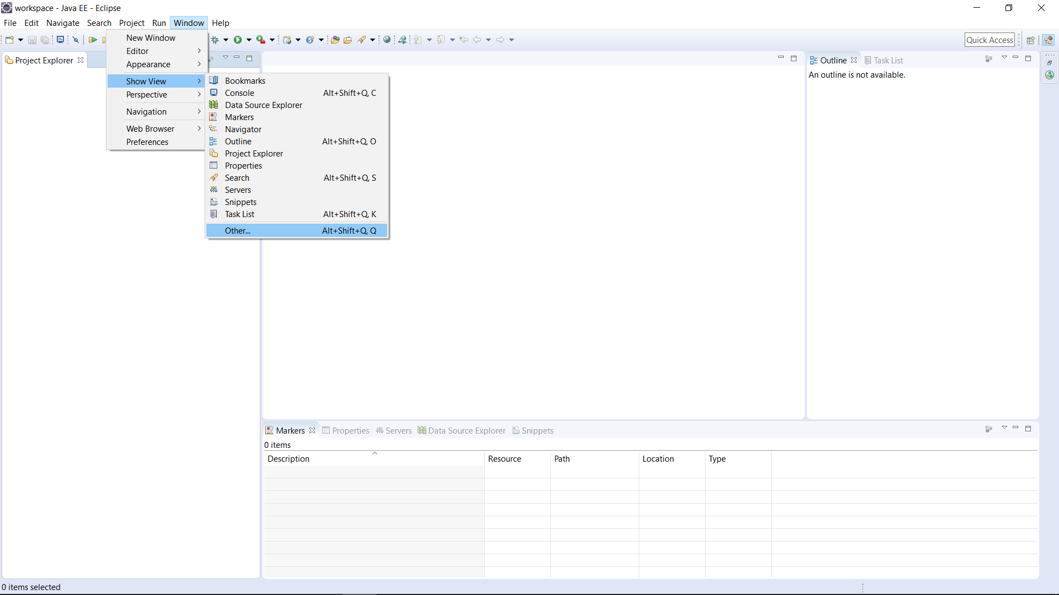
Follow the navigation

Slide 14
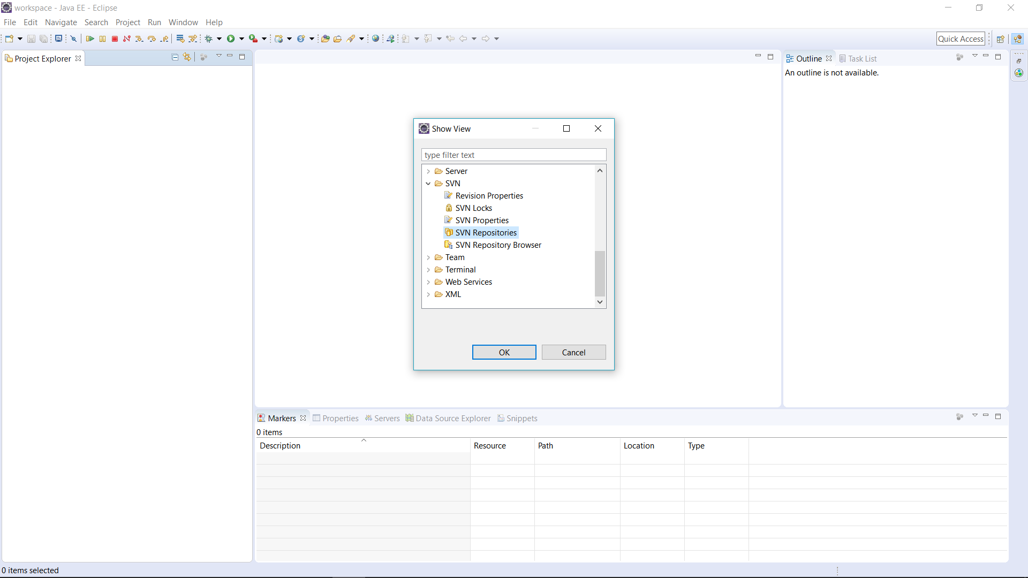
Follow the navigation

Slide 15
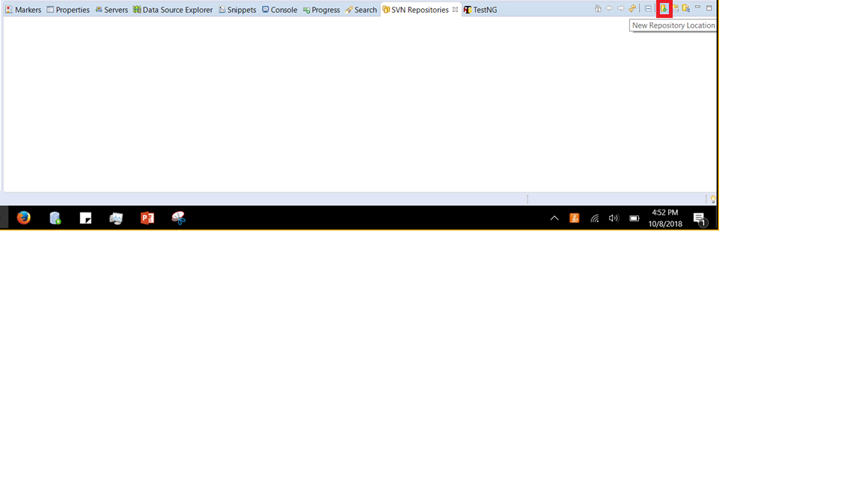
Click on add New Repository Location

Slide 16
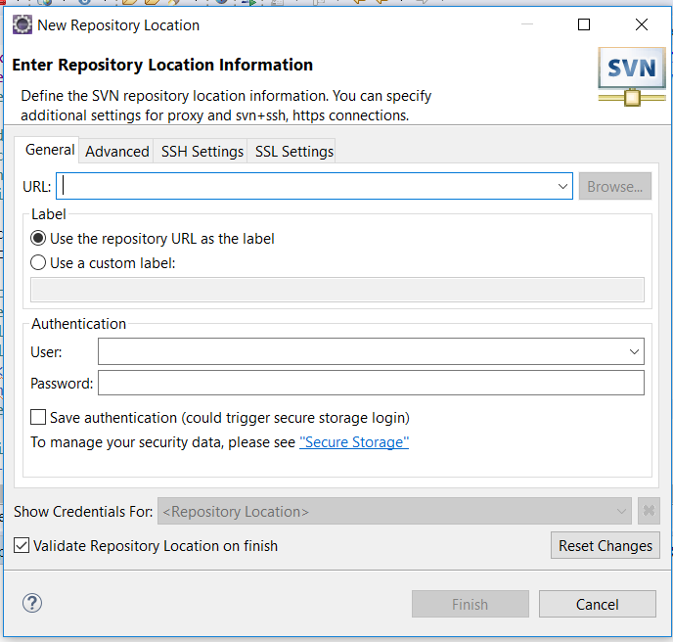
Enter the URL, id and password provided below
URL: https://usmumbhakulka-r.us.deloitte.com/svn/RPA_HGV/OctaOne
User: kartik
Pwd: rpa123

Slide 17
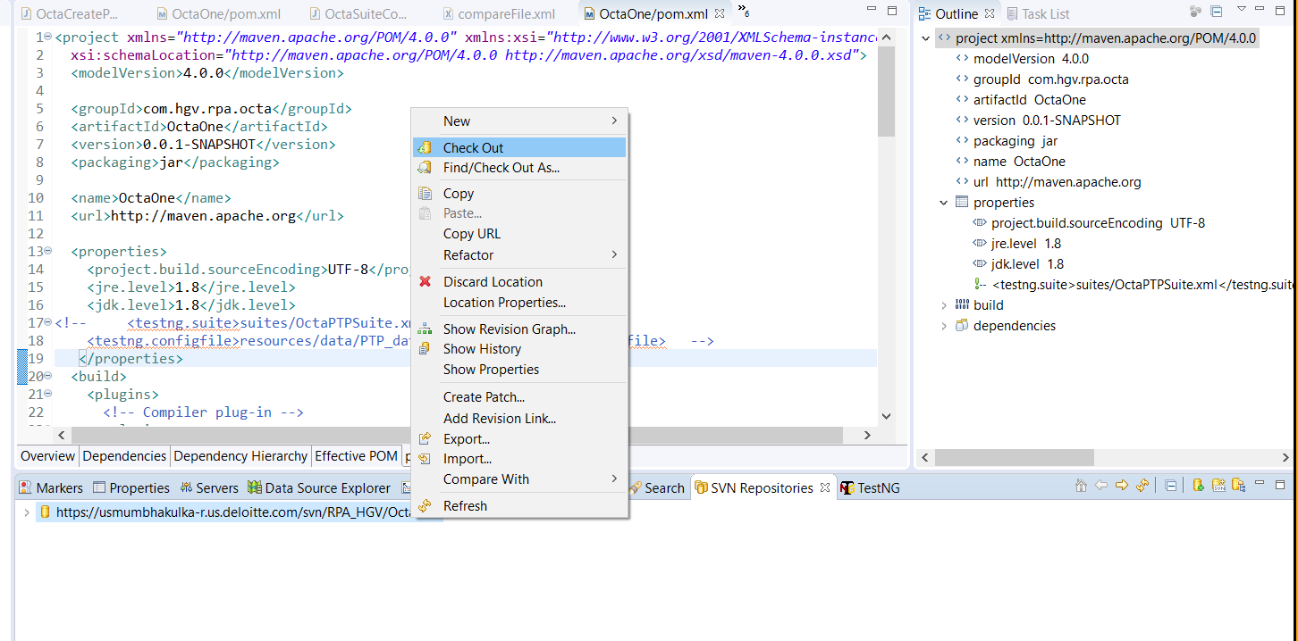
After entering repository details, proceed with checkout.

